Slide 1
desperately need our help
beyond help
the doctor is in

Slide 2
U.S. Bureau of Labor Statistics
Software developers
Sales managers
Marketing managers

Slide 3
Notes:
And, frankly, developers can be not the nicest people and can be kind of difficult to work with. And they are sometime these shadowy characters
Wouldn’t it be nicer to work with someone more upbeat and sunny? And maybe also get more suntan in the process?

Slide 4
these people need our help

Slide 5
Market research questions
What percentage of
the population between 30 and 50 use both cable and streaming services like Netflix?
Are men or women responsible for shopping for pet food?
Do people between
20-30 play more video games than those between 30-45?
Do you like the new Microsoft company logo better than the old Microsoft company logo?
Which video game console do you prefer?
Have you paid for a cable TV subscription
in the last year and, if so, are you likely to have a Hulu subscription?
What kind of jeans
do you wear?
(Skinny/straight/loose, etc.)

Slide 6
Large-scale Polling with InterPoll
Ben Livshits
Todd Mytkowicz
Microsoft Research
Notes:
Which takes me to our project we call InterPoll, for internet polling

Slide 7
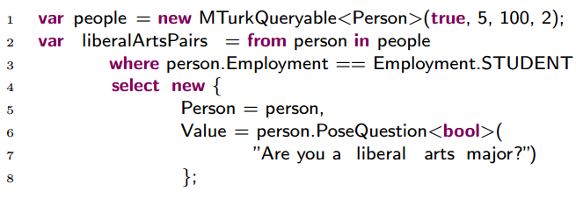
InterPoll 101
We want to give access to polls and survey to the regular developer.
This is a LINQ query for asking college students whether they are liberal arts majors
We want to make access to human-generated data as easy as access to databases.

Slide 8
Simple LINQ Queries
var femaleHeight = from person in people where person.Gender == Gender.FEMALE select person.PoseQuestion<int>("What is your height?");
var maleHeight = from person in people where person.Gender == Gender.MALE select person.PoseQuestion<int>("What is your height?");
if (maleHeight.ToRandomVariable() > femaleHeight.ToRandomVariable()) {
Console.WriteLine(
"Males are taller that females, according to a t-test.");
}

Slide 9
Our focus is on an end-to-end process
1) idea
3) crowd
4) analysis
2) poll

Slide 10
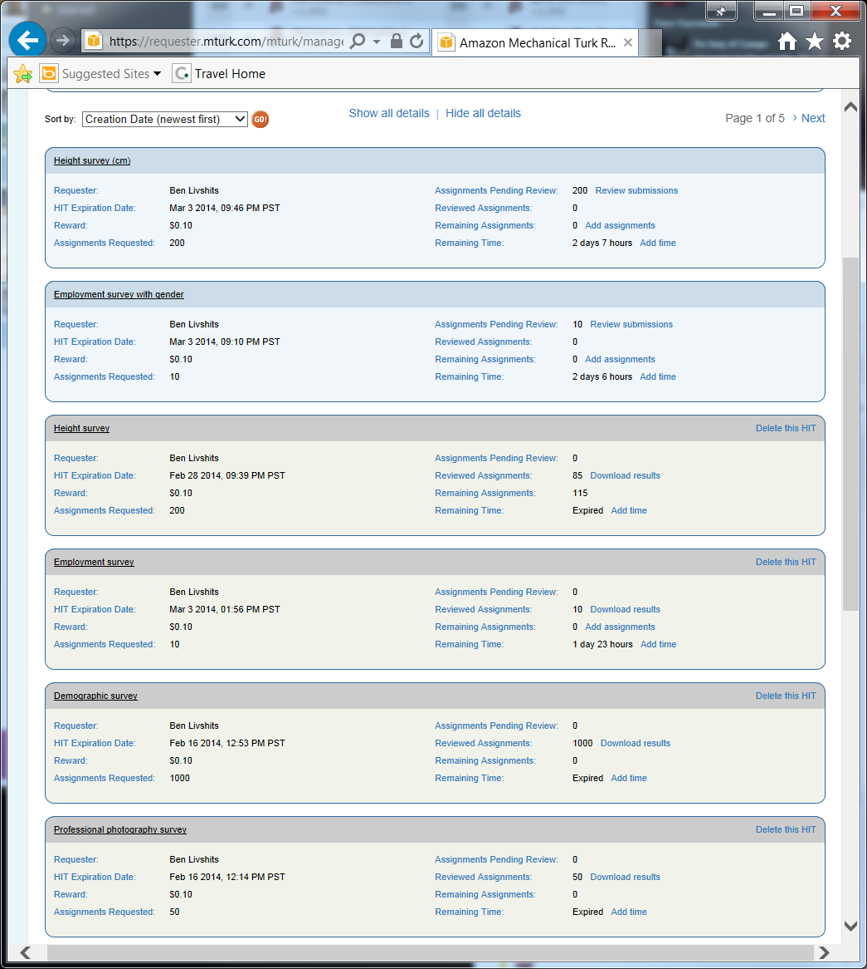
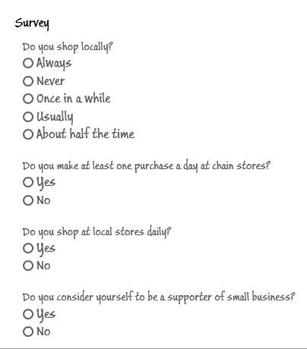
Sample Surveys

Slide 11
Is this not a solved problem?
SurveyMonkey

Slide 12
Moving away from small and unrepresentative samples
“Experimental psychology is the study of the college sophomore” Quinn McNemar, 1946

Slide 13
Key FEATURES of InterPoll
Programmable: integrates human and machine computation
Gets results cheaper; only as many samples as are needed are obtained (power analysis)
Results are representative (unbiasinging)

Slide 14
Outline
1) Power analysis
2) Unbiasing
3) Optimizations

Slide 15
Power analysis
Determine the number of samples for a query
We can sample from the crowd sequentially until we satisfy or disprove our hypothesis.
We will poll the crowd for more until our stopping criterion is reached.
The sopping criterion allows us to conclude that he hypothesis can be proven or disproven with the required level of confidence.

Slide 16
Example question: HEIGHT
N=29
Once we remove the outliers
height = from person in height where
where
person.Height >=140 &&
person.Height <=220)
N=27

Slide 17
Convergence curves: sequential probability ratio test (SPRT) or WALD, 1945
=a
=b

Slide 18
Debates: intelligence squared

Slide 19
Does money buy happiness (or at lest tranquility)?
Are rich more anxious than poor?
N = 105
expected value for poor=8.5714,
expected value for rich=7.9619

Slide 20
Taxation, by gender and Income

Slide 21
Priors for the crowd
Instant.ly crowd
US census

Slide 22
The Unbias operator

Slide 23
Unbiasing Results

Slide 24
Financial Optimizations
PL optimizations
InterPoll optimizations
Maybe 10% of the runtime
Maybe milliseconds
Even that is difficult and unpredictable
Saving hundreds of dollars
Waiting hours and days (or weeks) less
Replacing tedious and expensive manual polling effort with large-scale automation

Slide 25
Why Optimize InterPoll queries and HOW?..
cost
error rate
time
DB
crowd
PL
Notes:
There are three major reasons to optimize InterPoll queries
Time, cost, and error rate
We will see a range of ideas from PL, DB, and crowdsourcing literature
InterPoll brings these ideas together

Slide 26
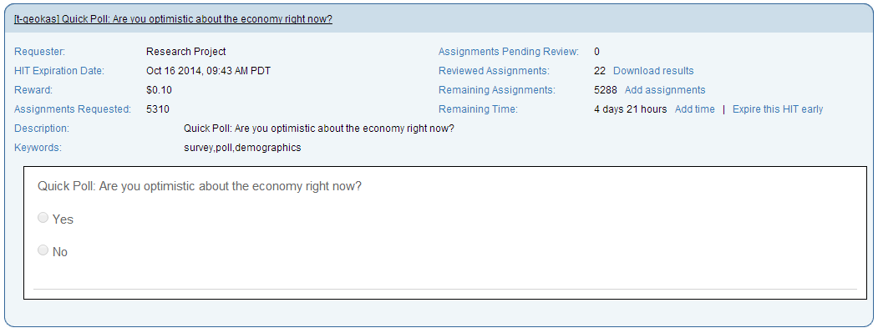
Why Optimize: Cost
cost
error rate
time
5,288 workers * 10¢ reward
=
$528

Slide 27
QUERY YIELD
var females = from person in population1
where person.Gender == Gender.FEMALE
select person.Employment;
var males = from person in population2
where person.Gender == Gender.MALE
select person.Employment;

Slide 28
Depends on the query: some filters have Low yield
20% or 10% yield is not great…
How about 1%?

Slide 29
Why Optimize: Cost (2)
5,288 workers * 10¢ reward at a 10% yield
=
$5,288
5,288 workers * 10¢ reward
=
$528

Slide 30
Why Optimize: Time
At this rate we will have to wait 10 days for all assignments to finish!
Notes:
22 workers after ~1 hour

Slide 31
TIME SAVINGS from Rebalancing optimizations

Slide 32
Why Optimize: Margin of Error
initial
unbiased
unbiasing increases
margin of error

Slide 33
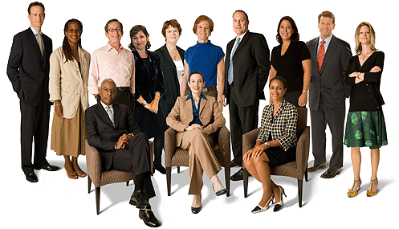
Panel building
Would it be possible to automatically construct a balanced panel?
This is what human polling experts do: they invite people to participate depending on which profile is needed
Unbiasing increases error rates
initial
unbiased

Slide 34
Overview of optimizations in this project
Static optimizations
Runtime optimizations
Flattening of complex LINQ trees
Query splitting
Common sub-expression elimination
Yield: cost
Rebalancing: time
Panel building: error rates

Slide 35
demo

Slide 36
Conclusions
InterPoll: a system for large-scale crowd-sourced polling
Geared toward
Developers who want to incorporate human data into their applications
But also social scientists
Marketing professionals
Campaign pollsters
Have explored power analysis
and are doing experiments
on unbiasing
and various optimizations

Slide 37
Building Interpoll applications

Slide 38
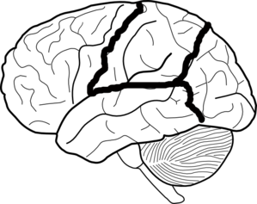
Social Sciences
What is the prevalence of depression in men vs. women?
What do you think about race relations in America today?
How near-sighted
are people over 50
What do you think about doctor-assisted suicide?
Which video game console do you prefer? Xbox One/PS4/Both/Neither)
Do you itemize your taxes or use the standard
tax form?
Do you think that affirmative action as part of college admission is a good idea?

Slide 39
Healthcare Surveys
How many hours of
sleep have you gotten on average in the past month?
Is Yelp a trusted
source of healthcare recommendations?
Do you feel that you
get enough sleep?
Which is worse for your health: alcohol, tobacco, sugar, or marijuana?
For people between
30-45, do they find medical providers by word of mouth?
How is duration of sleep correlated with coffee intake for college students?
Are parents satisfied with the amount of sleep they get?
Are men more satisfied than women?

Slide 40
Exploring the data

Slide 41
Political Polling
In cases of extreme drought, should farmers and food producers have priority when allocating water?
How do you feel about the direction of the country?
Should individuals obtain permission to photograph every person in the photos they take?
How did you or will
you pay for higher education (anything post-high school)?
Are you in favor or against raising the federal minimum wage?
Should legalized recreational marijuana be required to be sold with a warning label?
Do you think Obamacare will make things better or worse for you and your family?

Slide 42
Demo: basic surveys

Slide 43
Other interfaces are possible

Slide 44
Costly… especially at scale
SurveyMonkey Audience pricing
Instant.ly cost per completed survey

